Slide 1
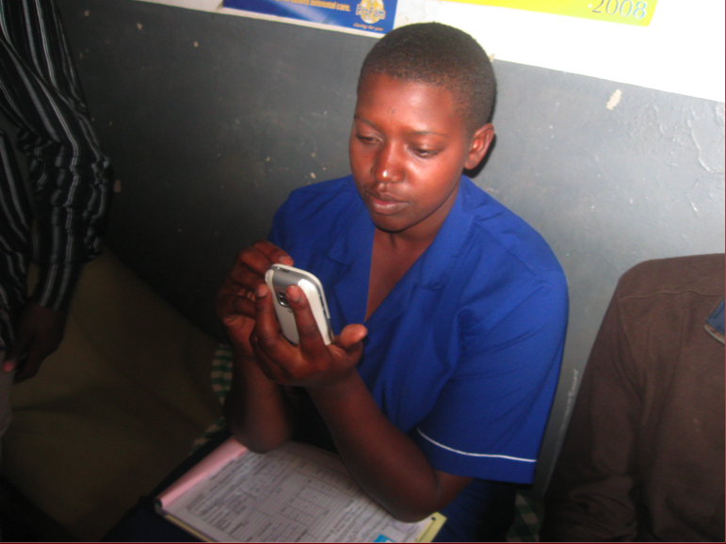
Mobile Phones, Health Information Management, and Output-Based Aid
Melissa Ho (Information)
Ben Bellows (Public Health)
Emmanuel Owusu (Iowa State)

Slide 2
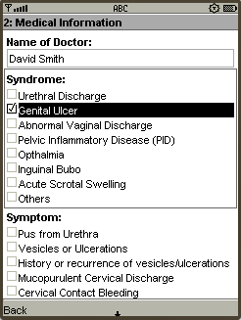
Claim Mobile
from paper form…
to phone
Using mobile phones as a platform for facilitating information management
  Dynamic, self-verifying forms
  GPRS-based form submission and approval
  Phone-based clinic data management
  Improved communications loop
Notes:
In a nutshell, this is a project that grew out of a white paper proposal, jointly written by me, and three other students at UC Berkeley, as part of a competition, in which we proposed to improve the claims processing speed of the Uganda Output based aid project by implemented mobile phone-based claims management.
In collaboration with Marie Stopes International, we proposed to deploy a number of mobile phones for use in the Uganda OBA project, with dual goals of reducing claim processing time and improving communication between the health care providers and the management agency running the OBA project.

Slide 3
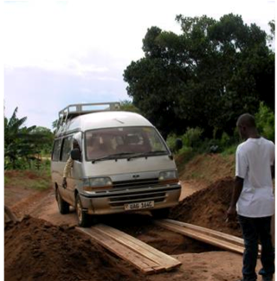
Roadmap
Technical Bit
Motivation
Methods
Process and Partners
Service Provider Perspectives
Initial Findings
Ongoing Work

Slide 4
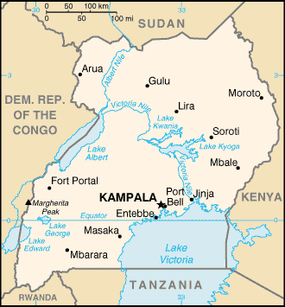
Uganda
Population: 31,367,972
Landlines: 162,300 (2007)
Mobiles: 4.195 million (2007)
Mobile GSM Coverage
Images from coverage maps available on gsmworld.com
Sexually Transmitted Diseases are an especially critical problem in Western Uganda
HIV prevalence: 10% of adult population (15-49 years)
Syphilis prevalence: about 5-7% of adult population
1 in 4 households had at least one phone.
39% reported STI symptoms
only 1/3 sought care
54% of respondents who sought any STI treatment reported using private clinics.
From 2006 Venture Strategies and Mbarara University population survey. http://www.oba-uganda.net
Notes:
Internet infrastructure
Uganda currently doesn’t have direct (I.e. wired) access to the global Internet, being located in East Africa.
All Internet access ultimately sources from VSAT connections, which are high cost and low bandwidth
Plans are underway to connect o India and Asia via several possible projects
Uganda, however, does have an Internet Exchange, which means that ISPs can exchange data directly
with each other, which improves performance within the country
Lots of Internet cafes available
Internet also available through mobiles
Mobile Coverage
2 million mobile phones - that’s 1 for every 15 people
This is a map of the GSM coverage for two of the providers

Slide 5
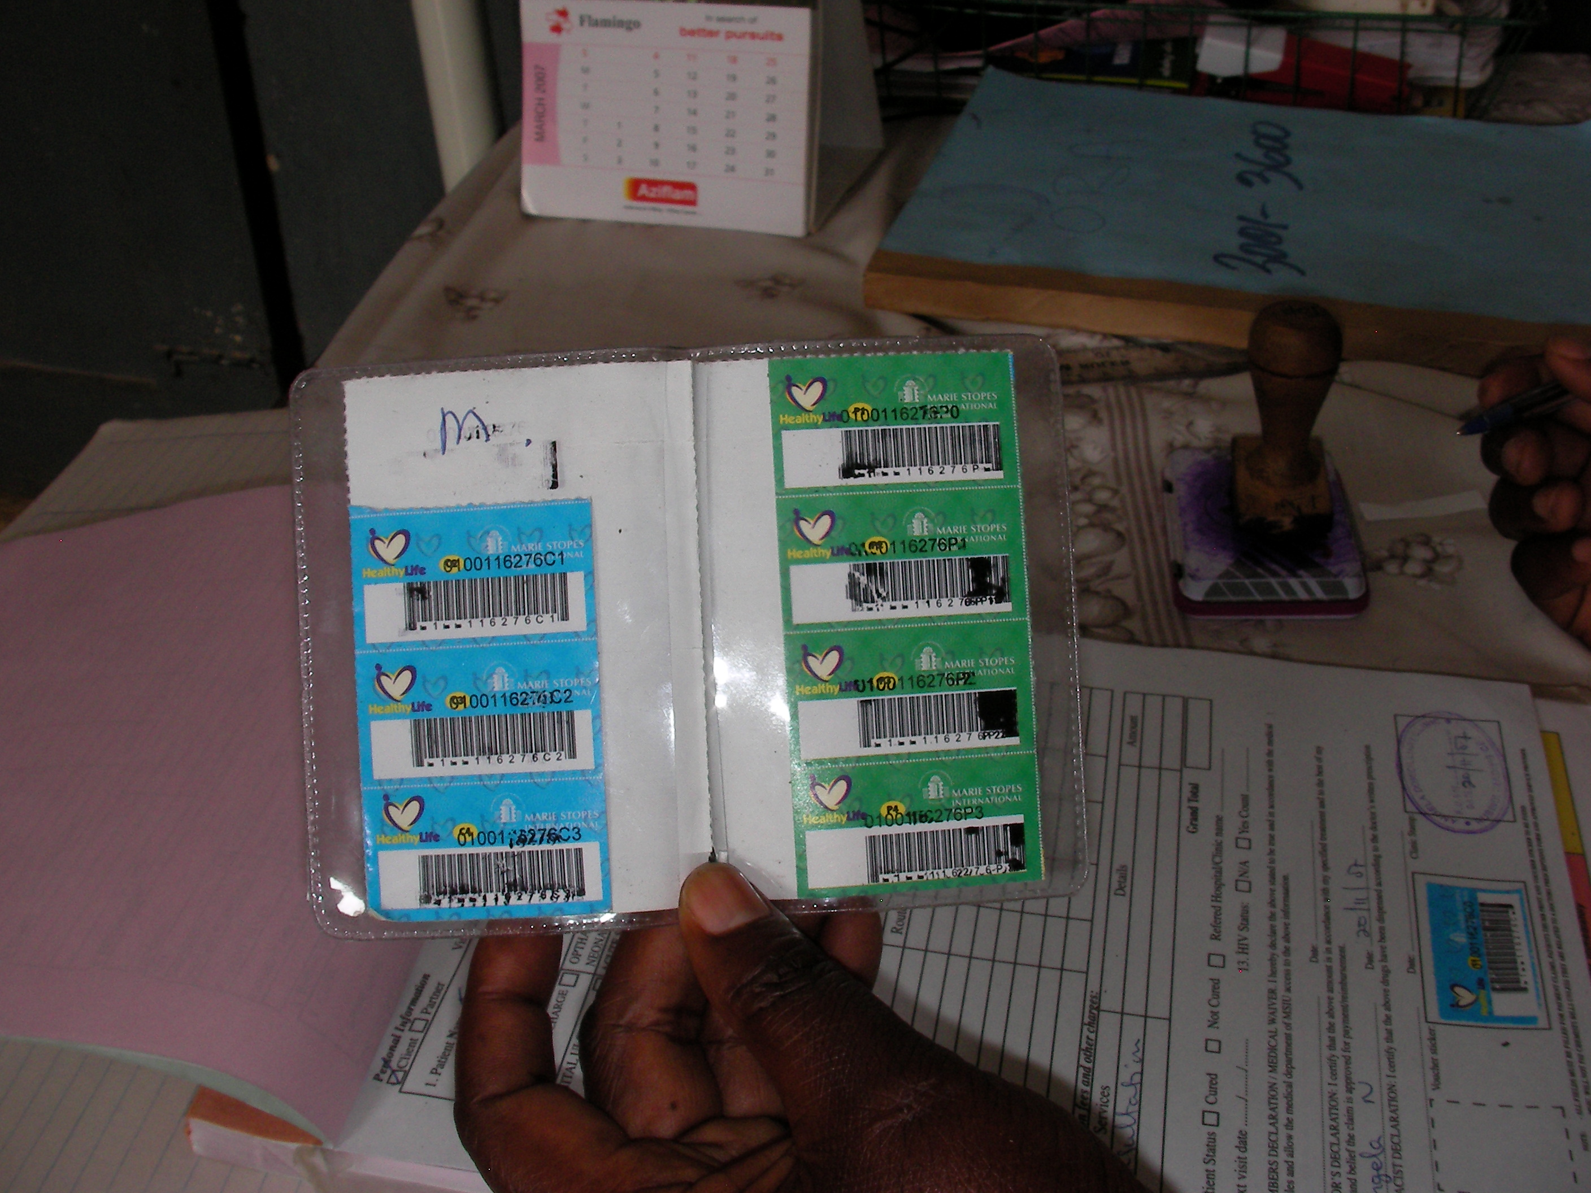
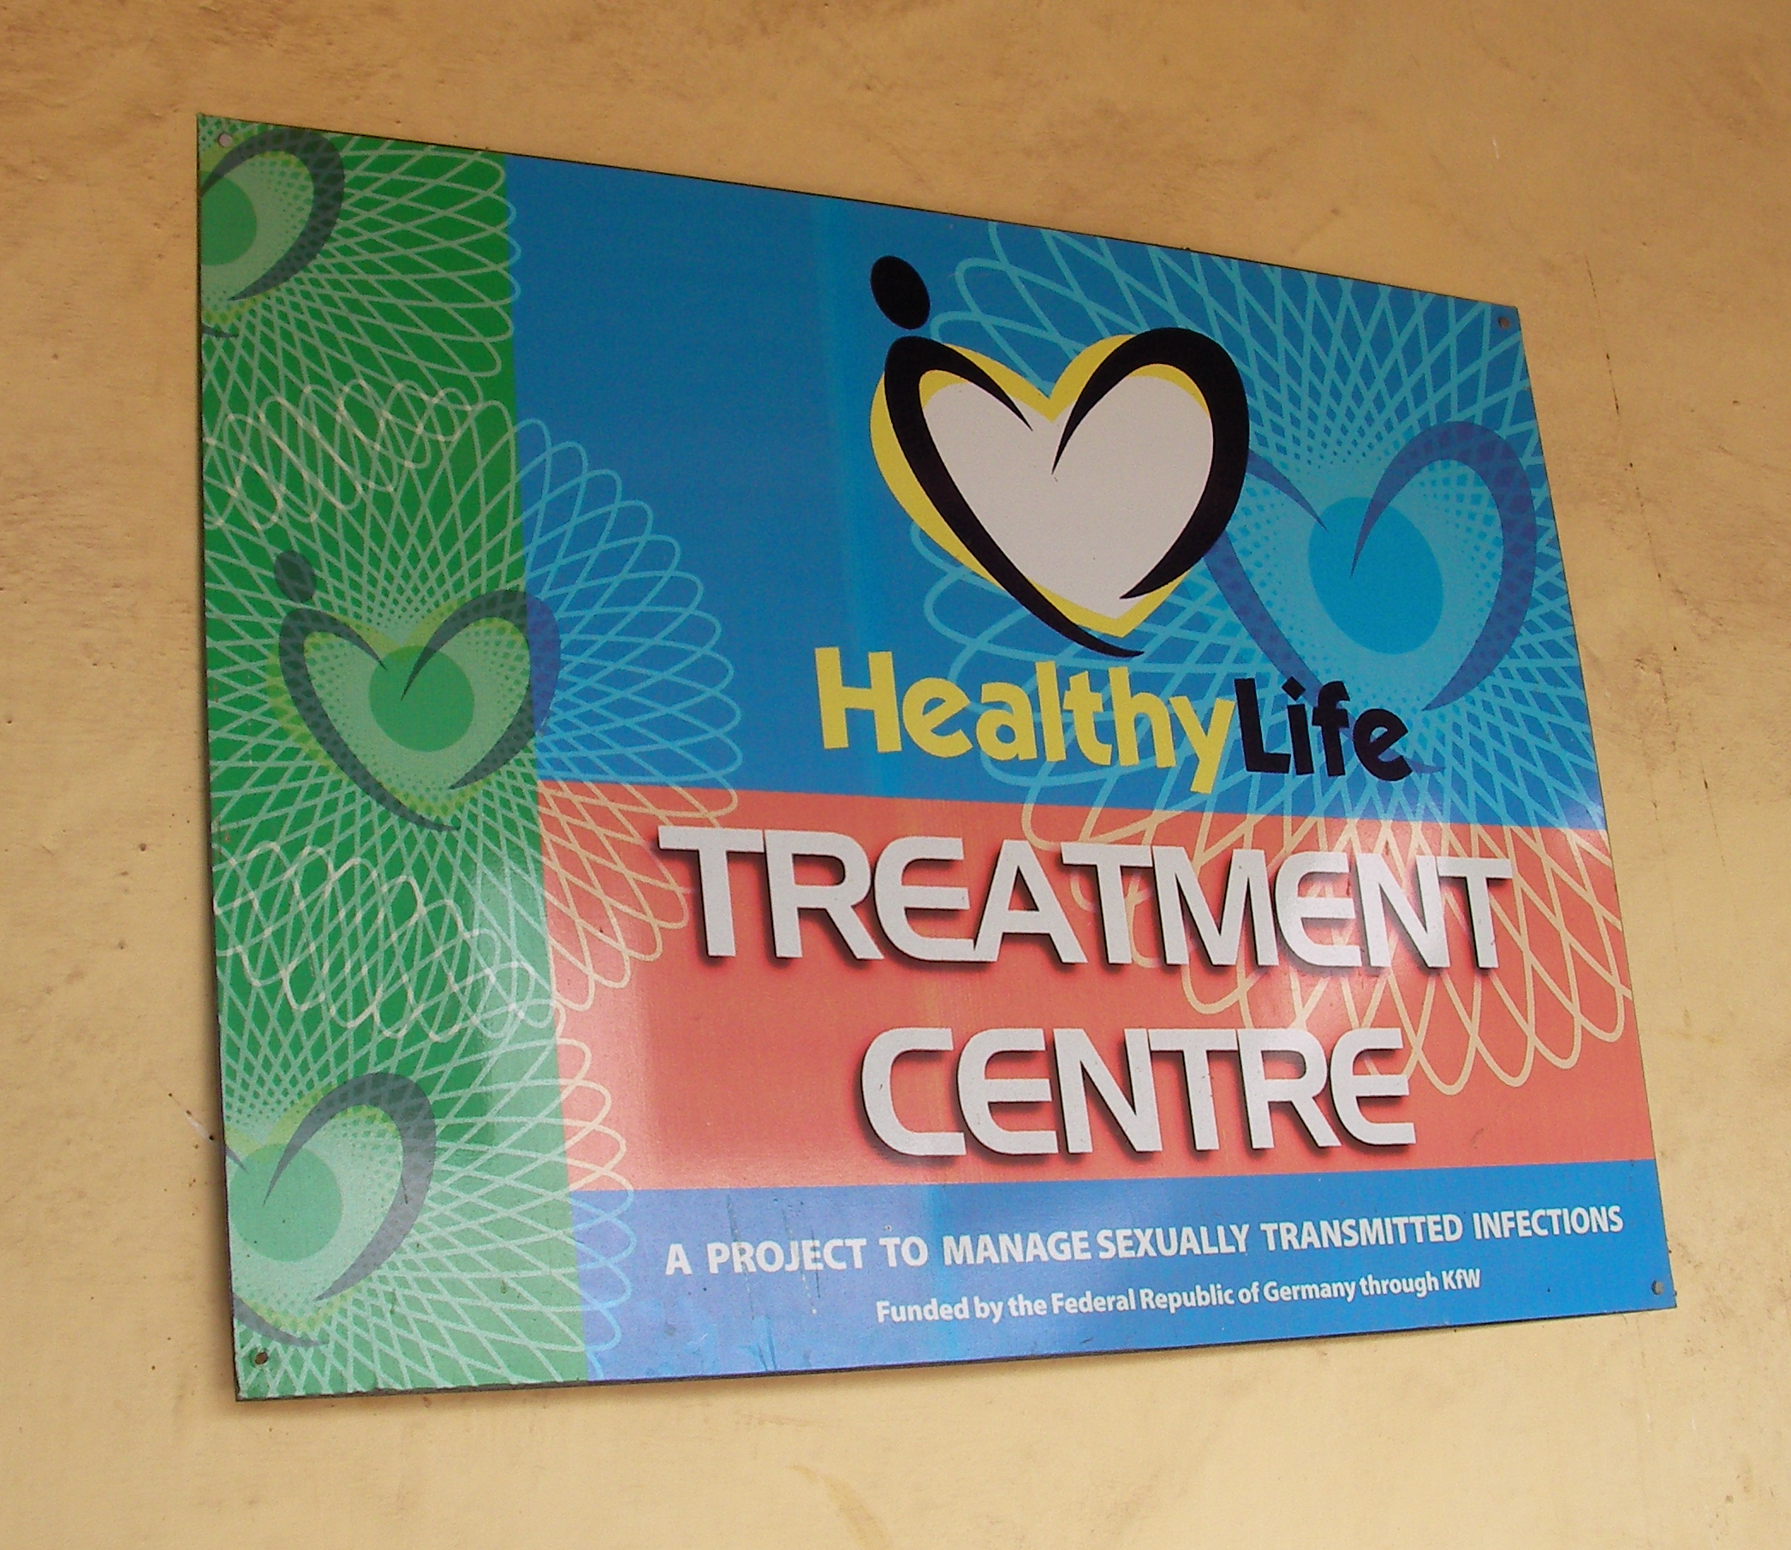
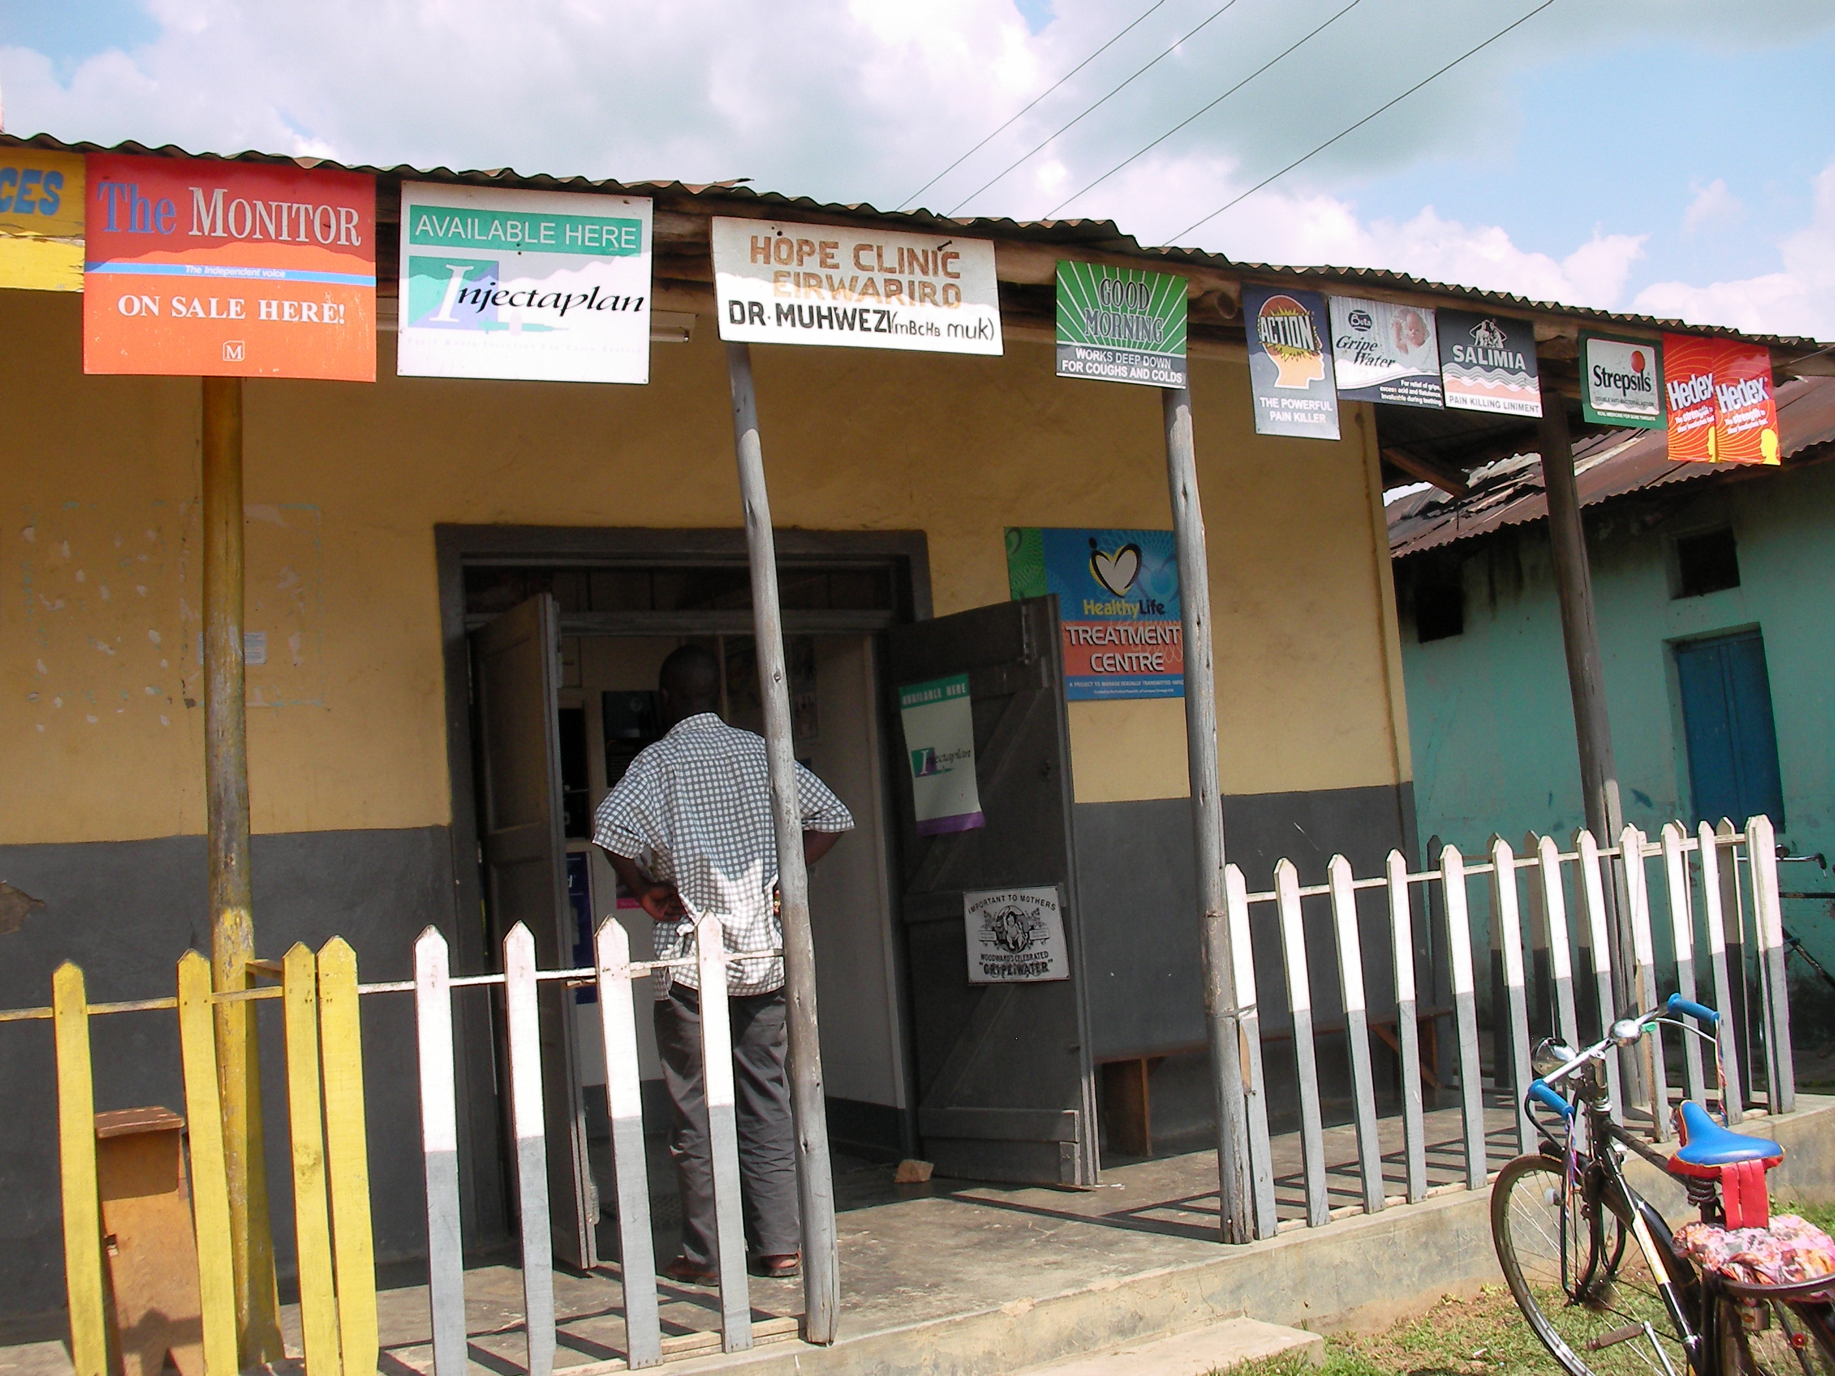
HealthyLife: Output-Based Aid
A voucher program that reimburses existing service providers for services rendered
But program management is information intensive
Notes:
Providing effective health care in poor countries is an essential component to economic development and poverty reduction. Unfortunately donors supporting this endeavor often find that resources given are not matched by desired gains. The output-based aid (OBA) model of financing seeks to address this by paying healthcare providers directly for services rendered instead of paying for the service provision up front. These “healthylife treatment centers” treat patients in exchange for bar-coded vouchers. The NGO managing the aid money then pays the service providers the cost of the treatment.
Unfortunately, the program management is information intensive, necessitating much paperwork to track and reimburse payment claims. Subsequent delays in payment cause hardship for participating clinics.

Slide 6
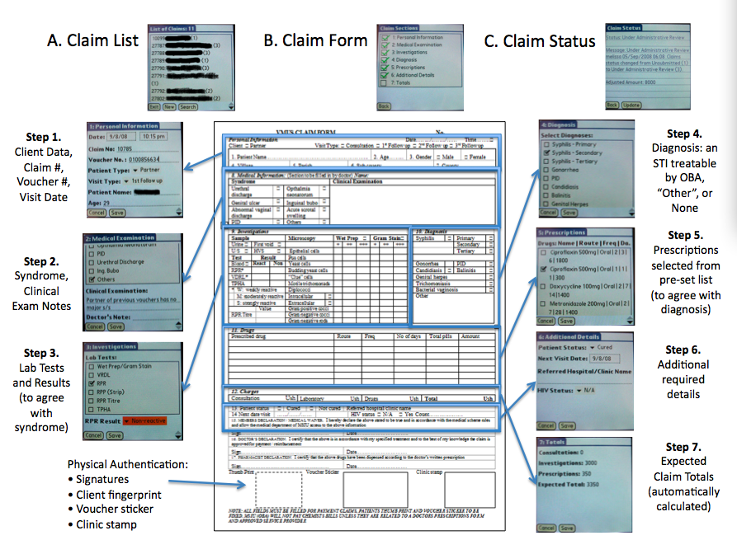

Slide 7
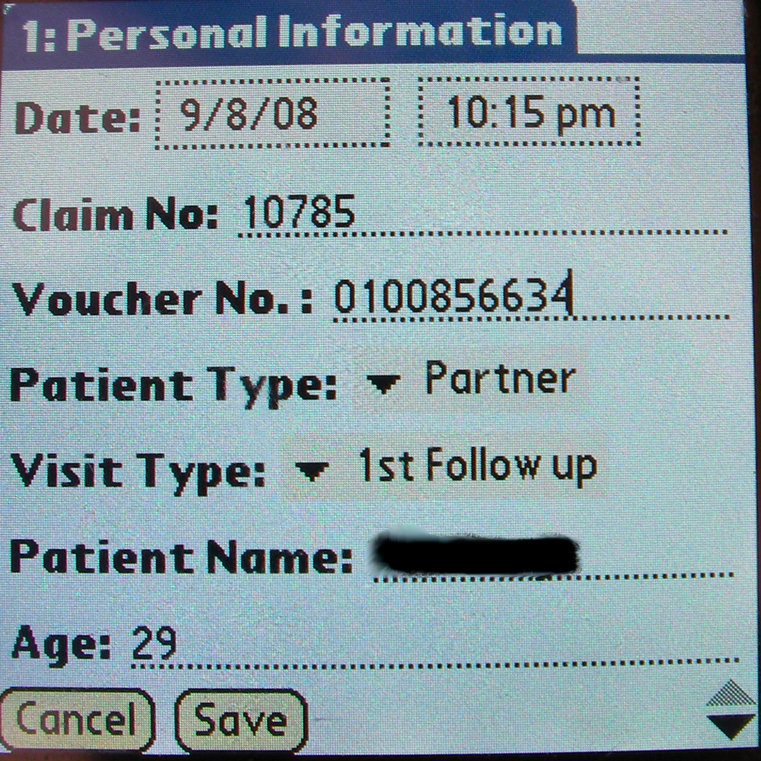
Claims submission
Patient data is securely entered & transmitted.
Check lists restrict data entry to only valid options.

Slide 8
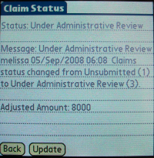
Closing the feedback loop
ClaimMobile provides for live update on claims payment and enables ongoing communication between management and providers on disputed claims

Slide 9
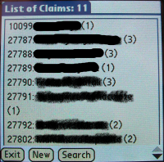
In-clinic claims management
Unique voucher numbers link patients and their referred partners across multiple visits.
Clinics can track trends over time

Slide 10
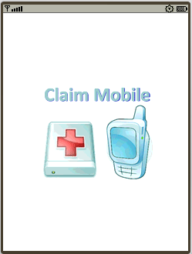
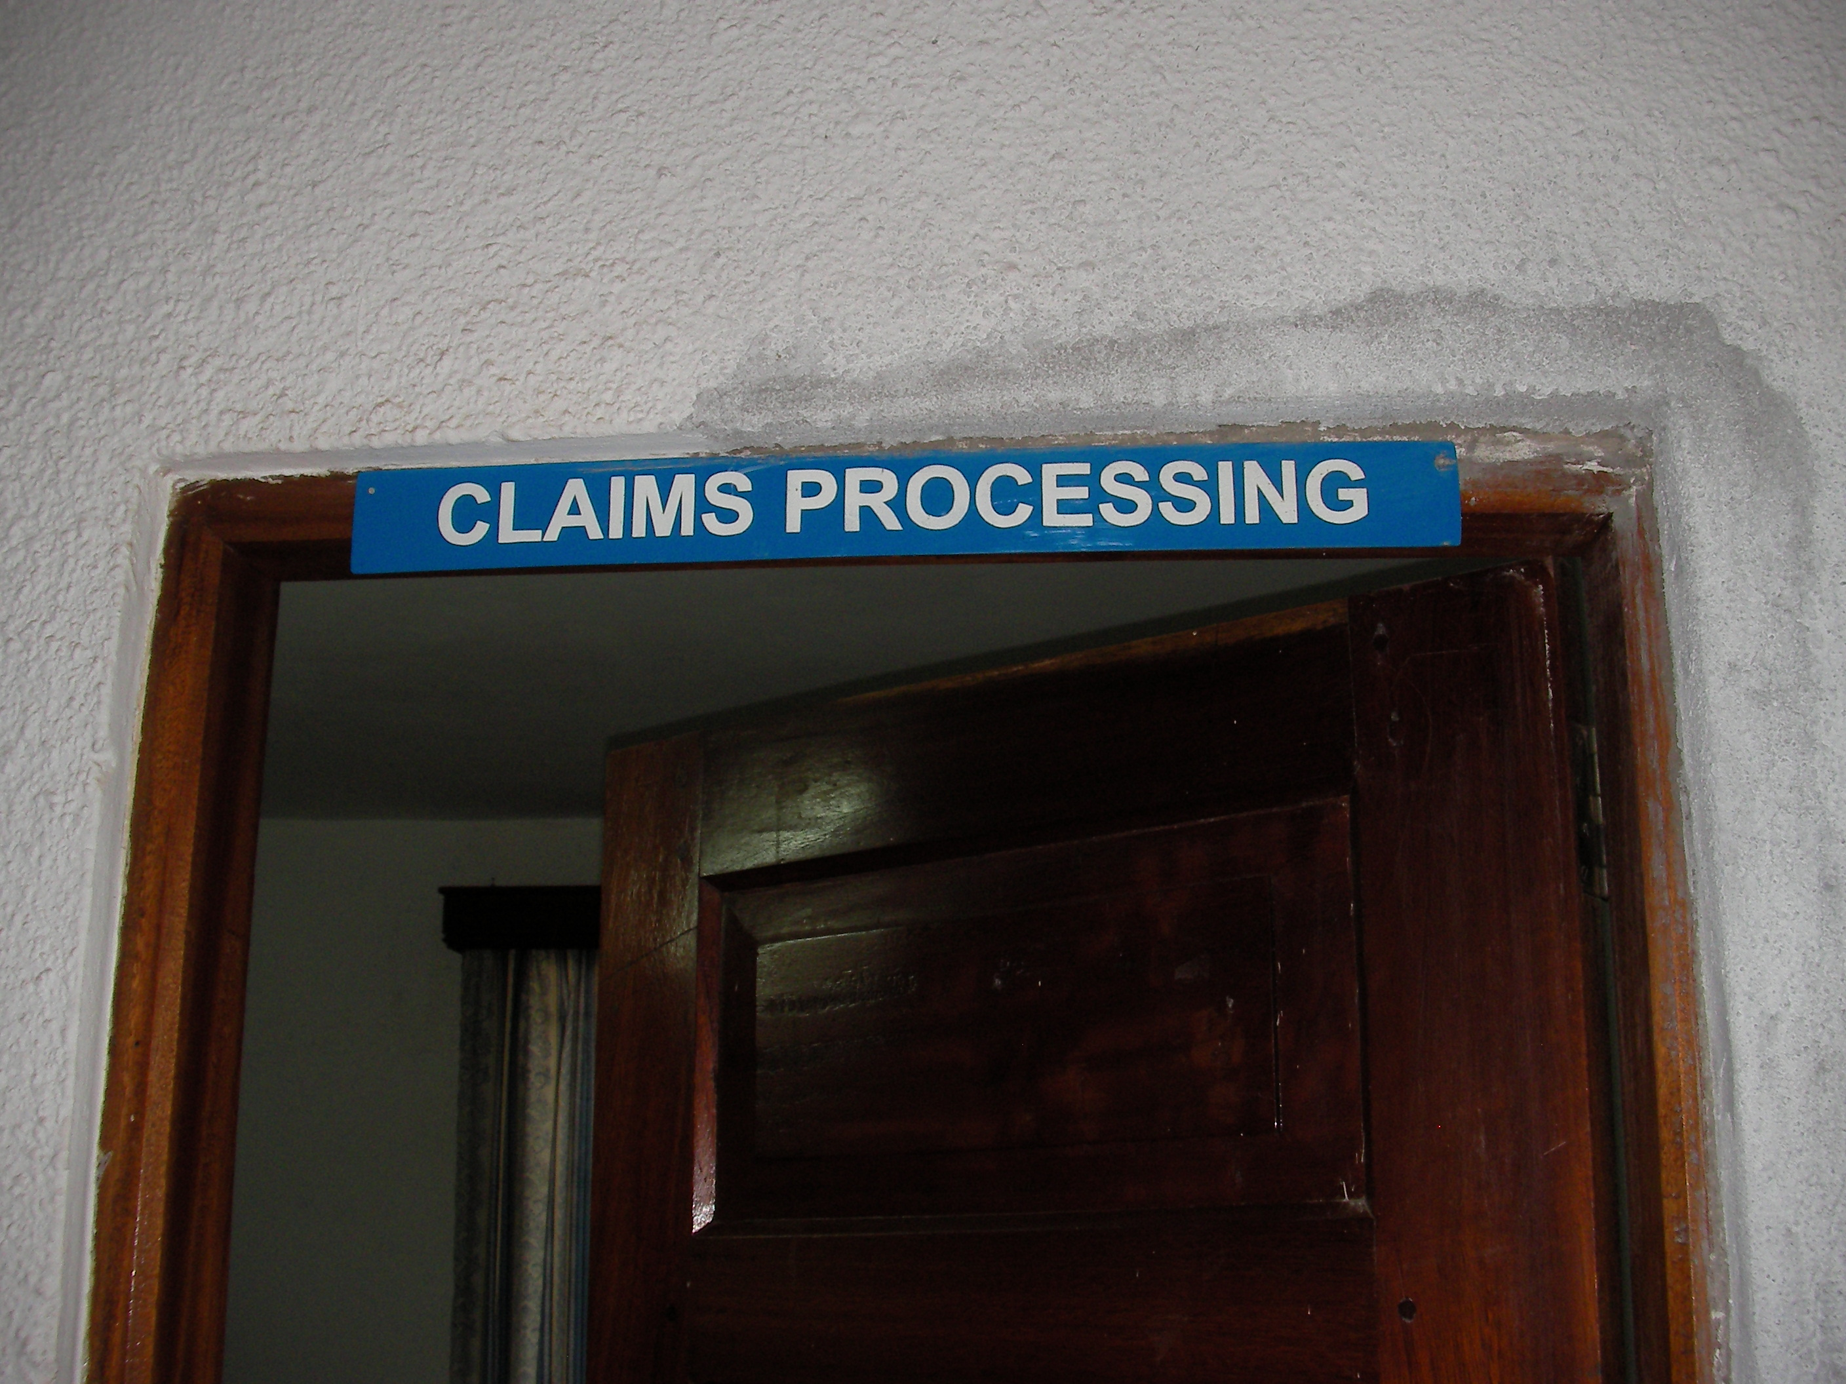
ClaimMobile Submission Process
Voucher Management System
Submit Claim
Update Claim Status
Payment Advices
Medical Review
Payments Processing
Annotate Claims
Program Announcements
Updates on Forms/Costs

Slide 11
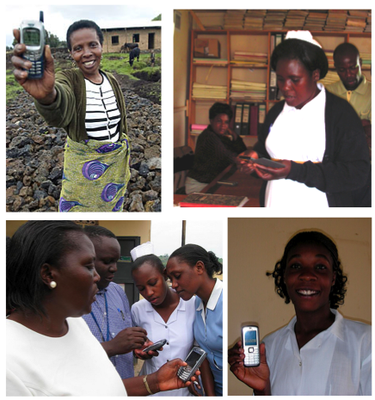
Mobile Phones and Development
Rural Data Collection
Diagnostics
Environmental Monitoring
Agricultural Pricing
Continuing Education
Telemedicine
Micro-entrepreneurship
Notes:
Needless to say, mobile phones have made a far-reaching and wide impact in Africa, and have been deployed for a variety of development projects ranging from rural data collection for epidemiological data tracking to advertising of crop price information.

Slide 12
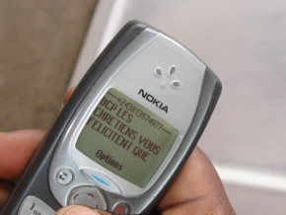
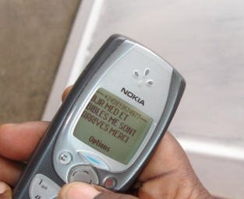
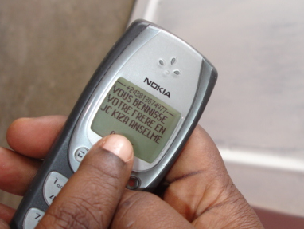
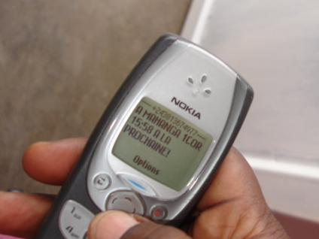
From the Rwandan rebels in North Kivu
“Good day, the medicines and bibles have reached me, thank you. Many Christians here celebrate your blessing in Christ, brother Kiza, to Mahanga.
1 Corinthians 15:58. Until next time!”
Notes:
Some of you may be keeping up with the news from Africa, and even in war-torn areas like North Kivu, the Democratic Republic of Congo, mobile phone infrastructure is widespread (but not ubiquitous). What does it mean to us, that even the leaders of the FDLR use mobile phones to communicate with the head nurse at the referral hospital in Goma – and that because they have mobile phones, this same head nurse is able to negotiate for the passage of food, doctors and trucks through rebel-controlled regions?

Slide 13
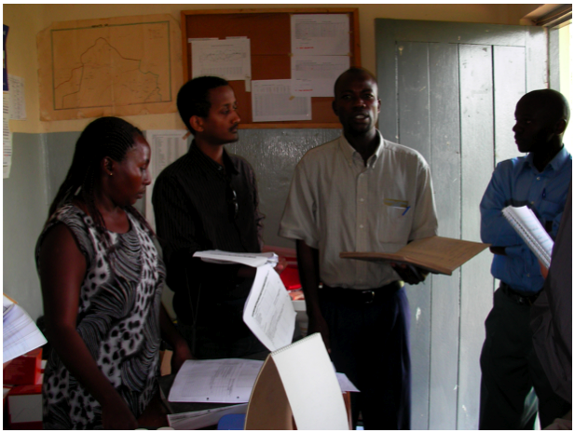
“Sometimes I use it as a torch”
Notes:
Now my research is, reassuringly for my friends and family, not based in the Democratic Republic of Congo. However, when we consider development projects which entail the deployment of mobile phones we must acknowledge that these phones are not being deployed into a vacuum.
What are existing practices around communication and information management
How does the introduction of information technology affect these practices?
How does the introduction of information technologies affect social networks, information flows, etc?
There are also larger order implications to information technology deployments – especially the pilot deployments typical of research projects – what happens when we leave, taking away the technology they found so useful, returning them to the tedious processes they used before? Or what happens if our deployments fail to take off, consuming time they would have otherwise used to see patients?
In this case of one pilot project we visited in Uganda – we found that the mobile devices actually entailed additional work for the biostatistian. all patient records were still maintained on paper, and had to be tallied by hand, and outpatient statistics were only transferred to the mobile device for reporting to the ministry of health once everything had been calculated. At this point, they copied the numbers in triplicate (by hand) onto paper so they could submit paper copies in addition to the digital data they were sending from the mobile device.
Yet they still coveted the mobile devices because they gained status because they owned them.

Slide 14
Field Visits and Methods
June/July 2007: Initial Site Visit
  Partner development, semi-structured interviews, clinic survey, document collection
November 2007: Baseline Assessment
  Semi-structured follow-up interviews on clinic survey, document collection
August 2008: Planning and Pilot
Jan 2009 – Dec 2009: Extended Fieldwork
March/April 2010: Followup

Slide 15
Timeline
Ongoing
Jan - Dec 2010
Implementation
Structural Context
Document Review
Iterative Analysis
Data Analysis
Dissertation Writing
Jan 2009 – Dec 2009
Extended Fieldwork
Participant Observation
Deployments
Periodic Interviews
Periodic Surveys
June/July 2007
July/August 2008
Initial Site Visit
Partner Assessment
Site Survey
Planning
Prototype Testing
Pilot Instruments
(surveys, interviews)
March 2010
November 2007
Follow-up Fieldwork
Semi-structured Interviews
Document Collection
Survey
Baseline Assessment
Semi-structured Interviews
Document Collection
April 2009
ICTD 2009
CHI 2009
2007
2008
2009
2010
Notes:
The blue boxes are for when I plan to be (or have been) in Uganda doing fieldwork. This gives an overview of what methods I’m using - including both quantitative and qualitative methods, as well as a rough timeline for what I’d like to do.
For my extended fieldwork, I can also break it down further. Basically I will be living in Mbarara, and rotating between the participating clinics, with occasional visits to the management agency in Kampala, about 6 hours away (by bus). By the end of my trip, my partners should be handling expanded rollout of the technology, and I will focus on observations

Slide 16
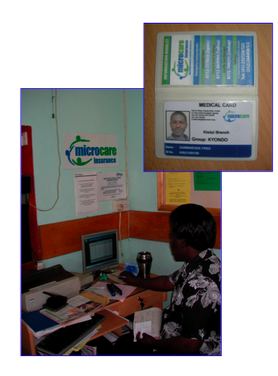
Stakeholders
Funders
  Global Partnership on
  Output-Based Aid
  German Development Bank
  (KFW Bank)
Program Management
  Marie-Stopes International
  Microcare Insurance
Uganda Ministry of Health
Participating Clinics and Hospitals
Notes:
Initial financing through KfW for STI pilot.
On October 24, 2007, the German Development Bank, KfW, and GPOBA signed a US$ 4.3 million grant for a voucher scheme that provides pregnancy and child birth related care for poor mothers as well as treatment of sexually transmitted diseases. The scheme will target households in rural and poor peri-urban environments in the greater Mbarara region in western Uganda, and it is expected that 255,000 poor people will benefit. It will work with existing private medical service providers, certified to deliver quality care. Participating service providers will benefit from a KfW-funded capacity building component.
What makes this program particularly interesting is that instead of trying to better provision the government clinic, or starting a new clinic that might provide free care, this program supports market based incentives by paying EXISTING clinics to provide specific treatments. In this program we’re working with both private clinics and non-profit, NGO-funded clinics, including a clinic run by Marie Stopes International, one of the program management agency partners.
Microcare…

Slide 17
Marie Stopes International Uganda (MSI-U) & Microcare Insurance Ltd.
Pay service provider
Submit claims
Record voucher sales data
Send vouchers
avg 30 days
max 60 days
avg 15 days
max 45 days
Clinics
(16 at start)
Community distributors
(44 at start)
Submit voucher to provider
Provide STI diagnosis and treatment
Pay
cash
Sell vouchers
Clients
(+350 per month)
Notes:
To quickly summarize the program design I want to highlight the transactional nature of the relationships between each of the principle actors. The nonprofit Marie Stopes International-Uganda and the private insurance company, Microcare Insurance Ltd together manage the OBA voucher project on behalf of the Uganda Ministry of Health. They send batches of vouchers to the distributors of which there were at the program’s launch in July 2006. The distributors in turn send back the voucher sales data to Marie Stopes and Microcare.
The distributors then sell the double vouchers at a 10% commission to clients. Distributors explain what the voucher service is about and makes sure that client is buying the voucher for STI services.
Why this thng
The clients give their partner one voucher and exchange their own single voucher for treatment at approved clinics.
Providers send claims with spent vouchers to the Marie Stopes and Microcare project office. After each claim is approved, electronic payment is made every two weeks to the providers.

Slide 18
Claims Submission Processing
Clinics
(16 at start)
Common errors
  Written errors
  Invalid client-partner use
  Invalid treatment
Submission delays
  Batched claims
  Transportation ($ + time)
Processing delays
  Data entry
  Medical & technical review
  Reconciling partial
  payments and rejections
  Payment
prepare claims
pay claims
batch claims
approve claims
deliver claims
data entry
Output Based Aid Management Agencies
Notes:
Most of the processing time is consumed in data entry and validation - to some extent the role of the smart claims is to reduce the data entry process and to streamline the data entry, while pipelining the batch process.

Slide 19
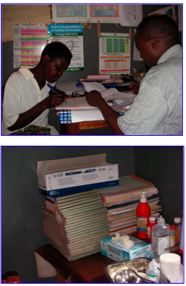
A Place of Contention
Hope Clinic
  Claims submitted: 100
  Approved: 58, $291
  Adjusted: 41, $191 paid, $88 disputed
  Quarantined: 1, $9
  Rejected: none
  Total Requested: $580
  Total Paid: $483 (difference: $97)
Angella Domicillary
  Claims submitted: 294
  Approved: 259 (88%), $1379
  Adjusted: 27 (9%), $149
  Quarantined: none
  Rejected: 8 (3%), $51
  Total Requested: $1642
  Total Paid: $1526 (difference: $114)
Notes:
The clinics actually use these claims forms as paper medical records

Slide 20
Service Provider Perspectives
I don’t know. I don’t know how we are performing. I don’t know how we are faring. And of course my staffs are also complaining. They are overworked, they don’t get any benefit from the project, and of course it takes a lot of time… They need to be motivated as individuals. All that will depend on - are we making any profits?
12/12 own a mobile phone
Timely processing
7 days: 2/12
14-15 days: 7/12
30 days: 2/12
4/12 have computer training
11/12 complete claims forms during consultation
3/12 have not gotten feedback
Providers travel up to 3.5 hours to submit claim forms
4/12 don’t know how many claims have been rejected

Slide 21
A Proposed Submission Process
Voucher Management System
Submit Claim
Update Claim Status
Payment Advices
Medical Review
Payments Processing
Annotate Claims
Program Announcements
Updates on Forms/Costs

Slide 22
Renegotiation
Current
Claim Mobile
Aid Agency
Aid Agency
University
Research
Funding
FMA
$
FMA
$
web
interface
$
claim
summary
reports
TMA
TMA
MPD
PMO
PMO
paper claims
and vouchers
paper claims
and vouchers
HSP
HSP
mobile phone
Notes:
FMA = financial management agency
TMA = technical management agency
PMO = program management office

Slide 23
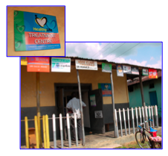
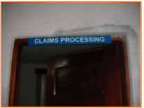
A Proposed Submission Process
Voucher Management System
Submit Claim
Update Claim Status
Payment Advices
Medical Review
Payments Processing
Annotate Claims
Program Announcements
Updates on Forms/Costs

Slide 24
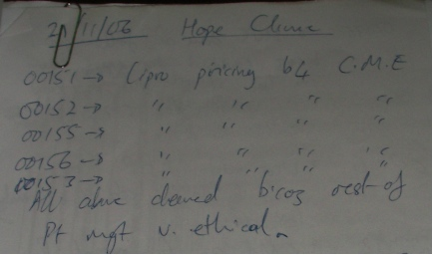
An Asynchronous Web Application
basic
claim
data
prices from database figures
messages
a warning with no penalty
update
statuses

Slide 25
Intermediate Implications
Intermediate Findings
Further Questions
Initially proposed system would have bypassed the PMO in Mbarara
Frequent changes in and sometimes ambiguous stakeholder requirements require flexibility in designs
Claims information is used as leverage in negotiations between stakeholders in the project – which has implications for a mobile system intended to improve its flow
How will the flow of information continue to be negotiated within the project?
How does democratization of access to information affect stakeholder willingness to participate in the project?
Will access to ClaimMobile improve communication between the management agencies and the service providers?
Can the phones be used to improve health information management in the health clinics?
Notes:
I think one of the interesting things about my work is that by attempting to implement a mobile claims system I was able to uncover in more depth this dynamic around the flow of information

Slide 26

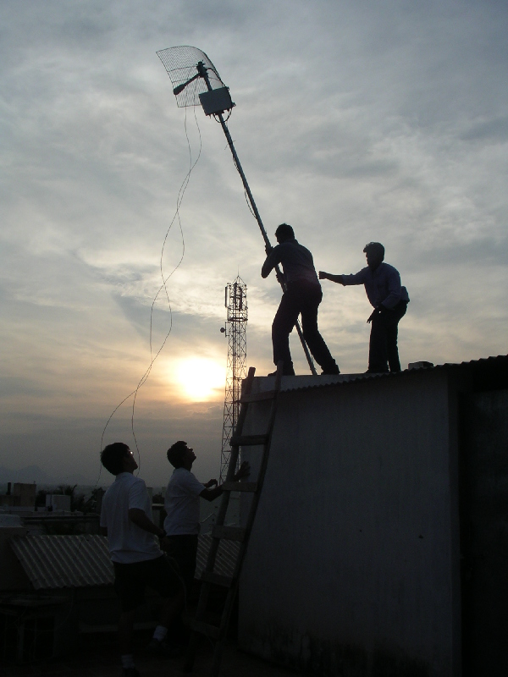



Melissa R. Ho mho@ischool.berkeley.edu http://www.melissaho.com
Technology and Infrastructure for
Emerging Regions (TIER)
http://tier.cs.berkeley.edu
Notes:
Acknowledge the funders …

